Slide 1

BLOCK CODING LEARNER
Session 47
Keyword Mapping

Slide 2


Recall…
What we have learnt in last session
What challenges you are facing

Slide 3

Keyword Mapping…
We will Learn today:
What is Keyword Mapping?
Learn with happy maps
Coding Logic

Slide 4
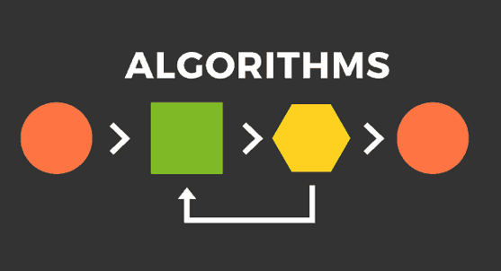
What is Keyword Mapping?…
Keyword mapping introduces you with ideas of learning computer science at core
Its main focus is on ALGORITHM
It is a list of instructions that you can follow in order to accomplish a task
We will take help of “Happy”, the squirrel, to teach us algorithm

Slide 5

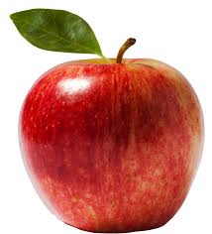

Happy Maps…
“Happy” wants to get to the apple which its just one step ahead
In how many ways “Happy” can reach the apple?
You should guide “Happy” directing him to move using any one of the arrows such as, up, down, left or right.
And once “Happy” gets to its fruit, you have the successful Algorithm

Slide 6
Happy Maps…

Slide 7
Happy Maps…
Write different algorithms for “Happy” to reach the apple
Algorithm here will be the directions in which “Happy” should move to get the apple

Slide 8

Algorithm & Programming…
In this way, you can write one instruction or two or more and it becomes more like a Program
So, what is the difference between an algorithm and a program
Algorithm is an easier version of the instruction, similar to any language you speak
Whereas, Program is already coded to be run whether you write it for a computer or a robot

Slide 9
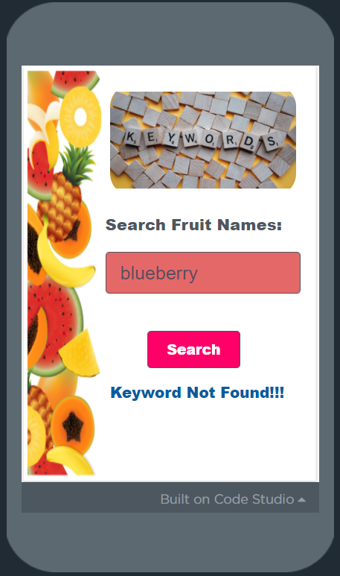
Keyword Mapping Algorithm…
We will create an App to search a fruit (keyword) from the created list of fruits
You need to map fruit names with search inputs
If the fruit name searched is available in the list it will say Keyword Found and if the fruit name is not available then it will say Keyword Not Found

Slide 10
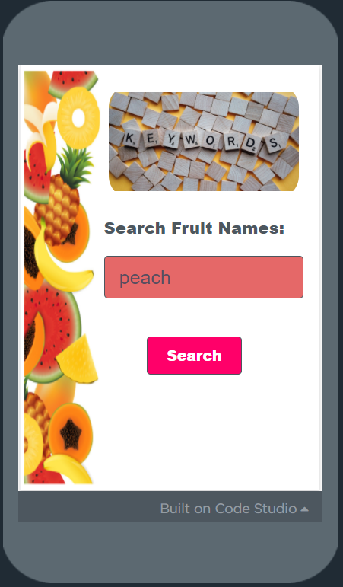
The UI Design…
Here, Enter the ‘fruit name’ into the textbox
Then click the ‘Search’ button

Slide 11
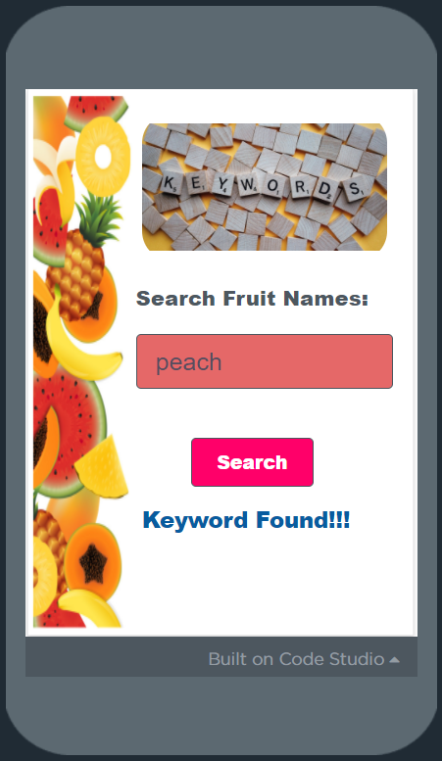
The Output…
If your typed fruit name is mapped in the list, then App prints the success message, ‘Keyword Found!!!”

Slide 12
The Output…
If your typed fruit name is not mapped in the list, then App prints the failure message, ‘Keyword Not Found!!!”

Slide 13
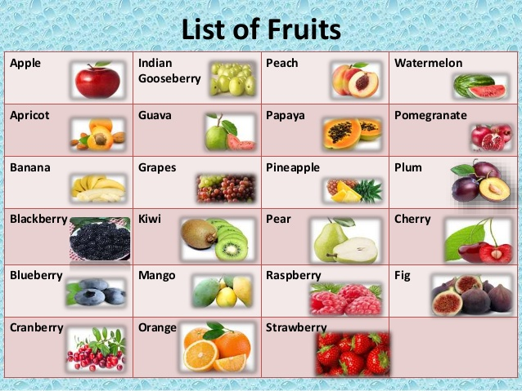
The Coding Logic…
List is used to store static values of fruit names
“When” search button is Clicked, we compare the text entered into the textbox “search_text” with the fruit name into the list
If match found, then “Set” the message as , “Keyword Found!!!”,
Else “Set” the message as , “Keyword Not Found!!!”.

Slide 14
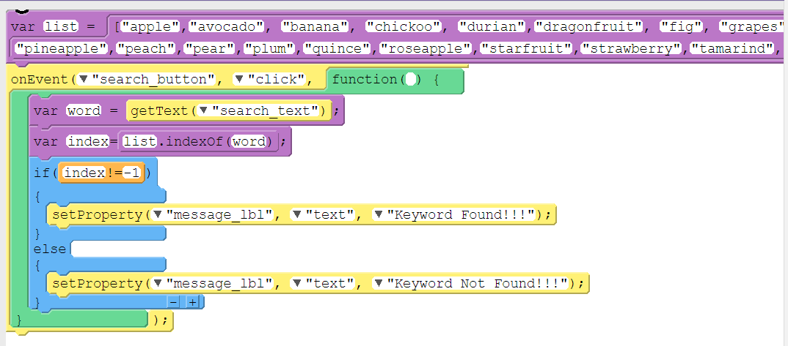
The Code…

Slide 15

Summary…
What is Keyword Mapping?
Learn with happy maps
Coding Logic

Slide 16
Next Session…
Artificial Intelligence:
Understanding AI?
Machine Learning
AI Training?
AI Applications

